Slide 1

2021 Stroke Prediction
Marriah Lewis and Glory Onyeugbo
IST 707 Data Mining Project

Slide 2
Background
When a blood vessel carrying oxygen and nutrients to the brain is either blocked by a clot or bursts, a stroke occurs.
Stroke is the No. 5 cause of death and leading cause of disability in the United States.
Up to 80% of second clot-related strokes can be avoided. There is strong evidence that high glucose levels can contribute to stroke.
Symptoms of stroke include trouble speaking and understanding, paralysis or numbness, lack of sight, headache, trouble walking.

Slide 3
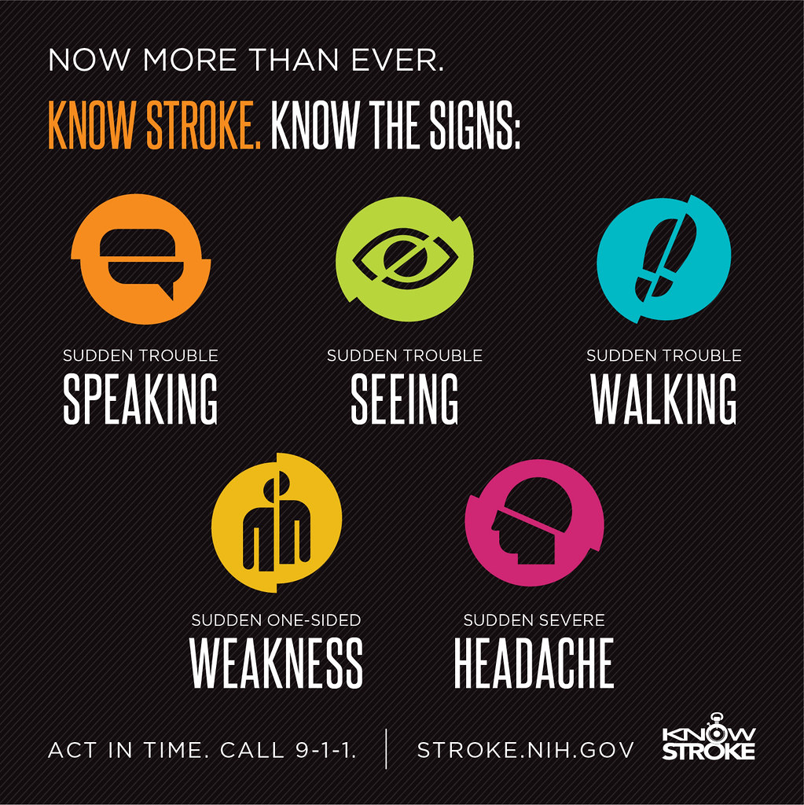
Who does stroke affect?
Can patients avoid having a stroke?
Can we make predictions based on medical history?
Can machine learning help? If so, in what way?

Slide 4
Motivation
Goal: Create a model to predict whether target patients had a stroke based on attribute subset.
Some stroke risk factors are gender, age, and family history.
Lifestyle factors that can increase the risk of stroke are smoking, high glucose levels, poor diet, and lack of exercise.
Notes:
Predicting an individual's risk of experiencing a stroke has become a research topic for many authors worldwide because it is a common disease with strong evidence that early detection of the risk can help with prevention and treatment. We are looking at the diagnostic and demographic factors that predict stroke risk

Slide 5
Problem Statement
The problem can be defined as follows: Determine whether a patient will have a stroke using historical medical information. This problem can be seen as a binary classification problem.

Slide 6
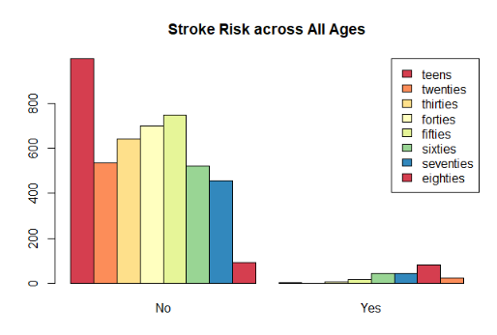
Data

Slide 7
Variable | Data Type | Description
gender | factor | Patient's gender: "Male", "Female", or "Other"
age | ordinal factor | Age of the Patient: "child", "teens", "twenties", "thirties", "forties", "fifties", "sixties", "seventies", "eighties"
hypertension | factor | 0: patient does not have hypertension, 1:the patient has hypertension
heart_disease | factor | 0: patient does not have any heart diseases, 1: patient has a heart disease
avg_glucose_level | numeric | Patient's average glucose level
smoking_status | factor | "formerly smoked", "never smoked", "smokes", or "Unknown"
stroke | factor | 1: patient had a stroke or 0: patient has not had a stroke

Slide 8
Data Cleaning
Check for duplicates
Replaces N/A and remove unnecessary columns
Convert datatypes
Recoding variables
Discretize Age

Slide 9
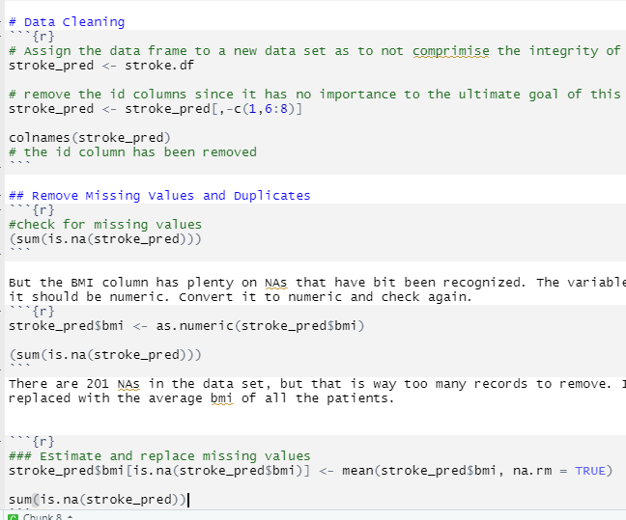
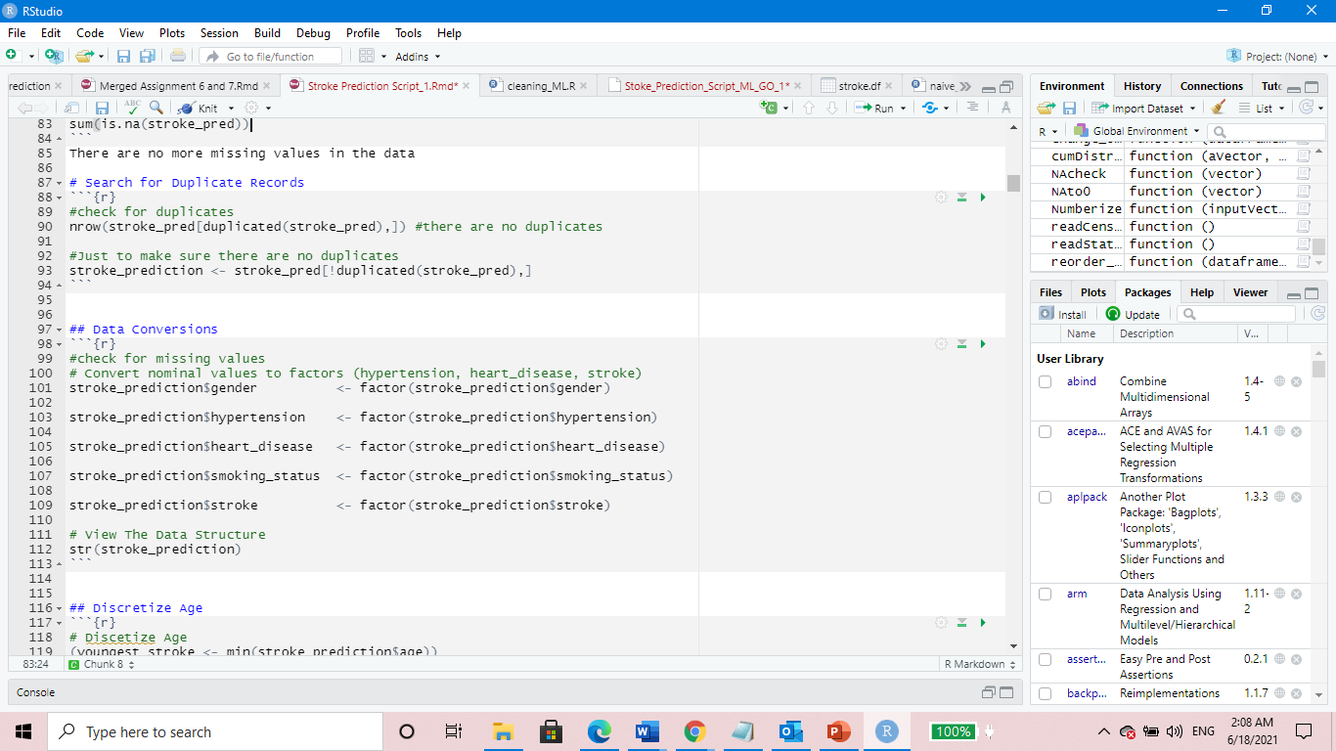
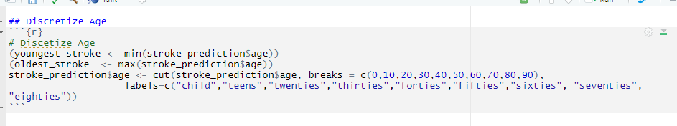
Cleaning R Code

Slide 10
Initial Results from EDA

Slide 11
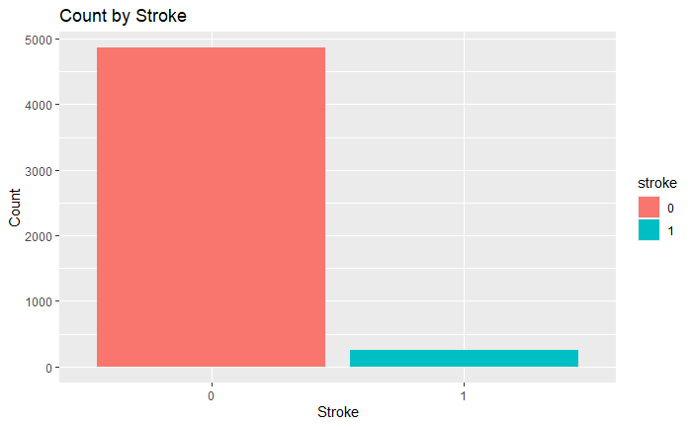
Target Variable
There is a huge class imbalance in this dataset. We will certainly address the imbalance for future models.
There are 5110 patients in this data set and only 249 suffered a stroke; the other 4,861 have not.

Slide 12
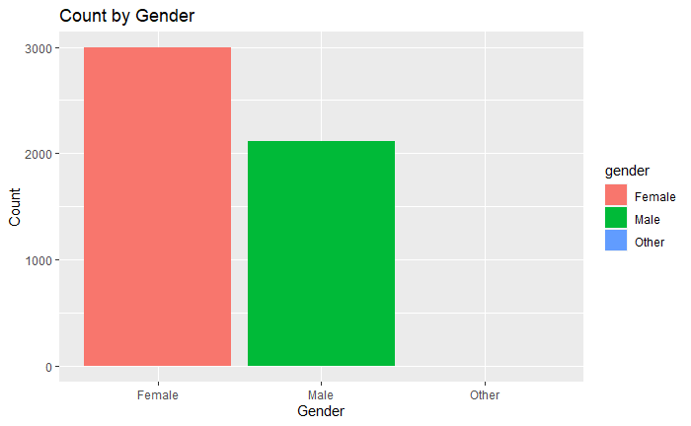
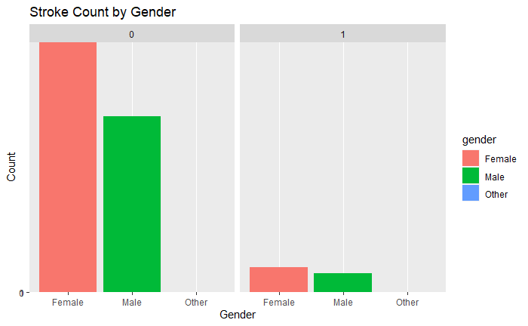
Results from EDA
There are 2994 Females in the data. 141 have suffered from a stroke.
There are 2115 Males in the data. 108 have suffered from a stroke.
The is only one patient who classifies as other but never had a stroke.

Slide 13
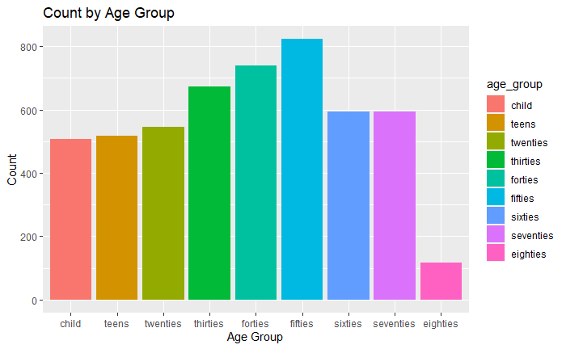
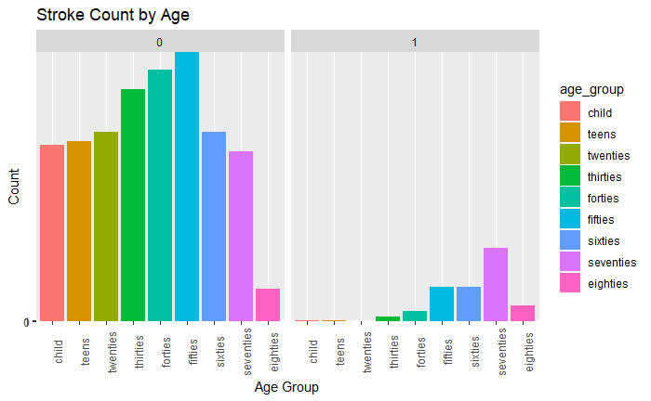
Results from EDA
507 children; 1 suffered a stroke
518 teens; 1 suffered a stroke
545 twenties; 0 had a stroke
674 thirties; 6 suffered a stroke
739 forties; 15 suffered a stroke
823 fifties; 49 suffered a stroke
594 sixties; 49 suffered a stroke
594 seventies; 105 suffered a stroke
116 eighties; 23 suffered a stroke

Slide 14
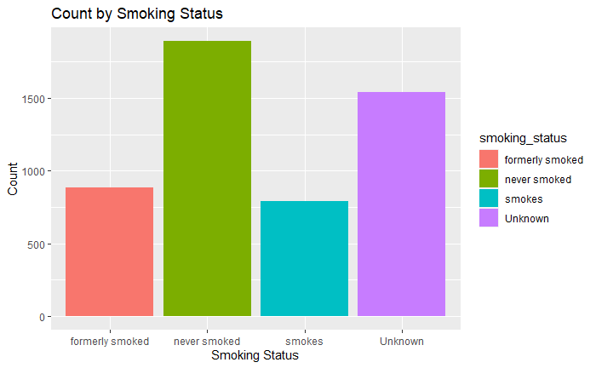
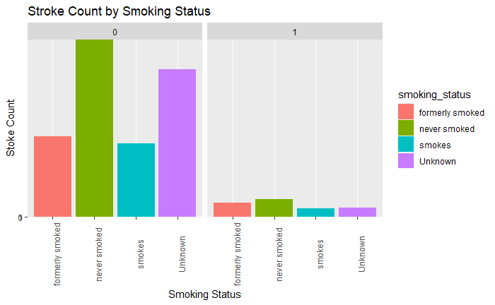
Results from EDA
885 former smokers: 70 strokes
1892 never smoked; 90 strokes
789 smokers; 42 strokes
1544 unknown; 47 strokes

Slide 15
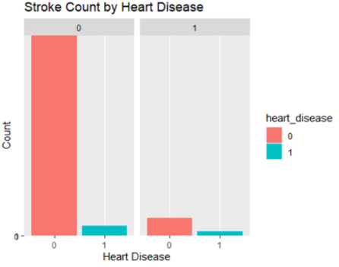
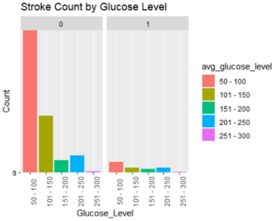
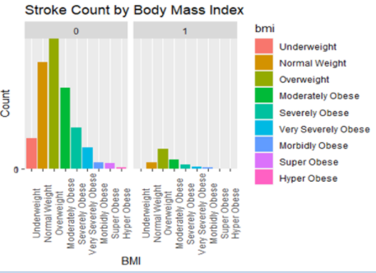
Count by heart disease, glucose level, and body mass index

Slide 16
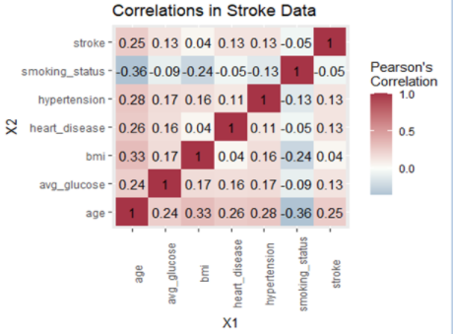
Correlation Analysis using the cleaned dataset
Stroke
Smoking status
Hypertension
Heart disease
BMI
Average glucose level
Age

Slide 17
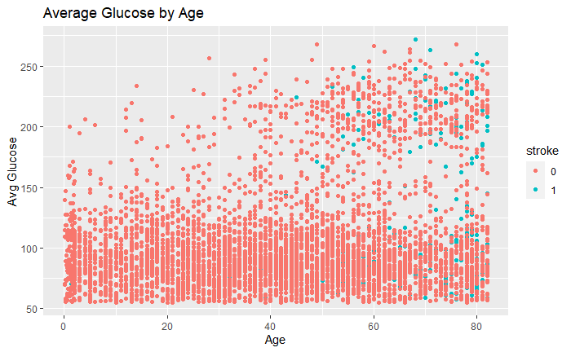
Average Glucose

Slide 18
Models and Analysis

Slide 19
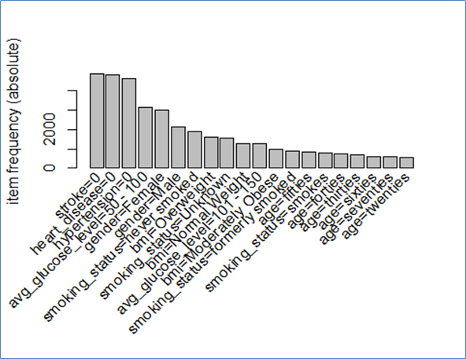
Association Rule Mining

Slide 20
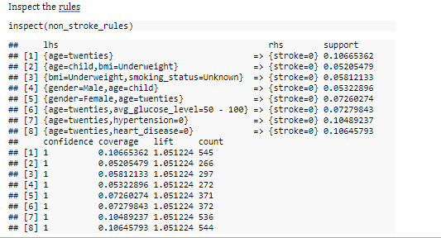
ARIMA Rules

Slide 21
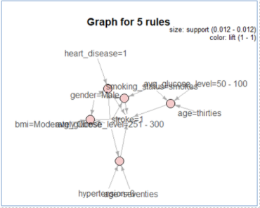
Association Rule Mining
Plot of total rules mined. Many descriptive variables can be seen visually that contribute to target patient with high risk for stroke those whose bmi is moderate, males, age=thirties, seventies, avg_glucose level= 50-100, 251-300, smokers, and have hypertension.

Slide 22
Challenges
Problem
As mentioned before, there is a class imbalance in this data set, i.e., the are many more instances of non-stroke patients than stroke patients.
The goal is to identify factors that can lead to a person having a stroke and this can be difficult when there aren't many instances of this happening.
Solution
Apply a synthetic minority over-sampling technique (SMOTE) to the training data.
This generates synthetic samples from the minority class to obtain a class-balanced training set.
The ubSMOTE() function from the unbalanced library is applied on the stroke training data set and is used to train the classification algorithms.

Slide 23
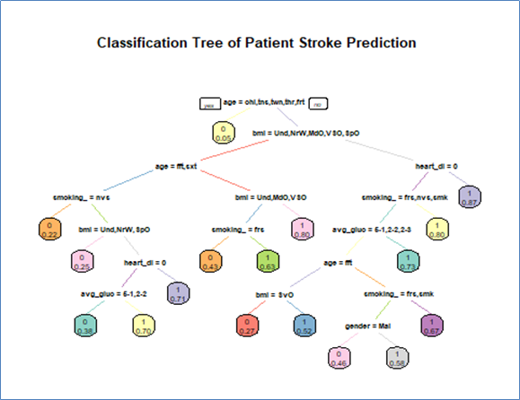
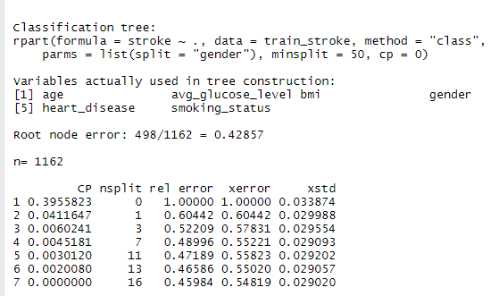
Decision Tree: All variables
74.35% Accuracy

Slide 24
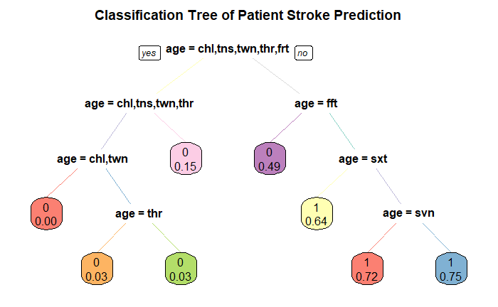
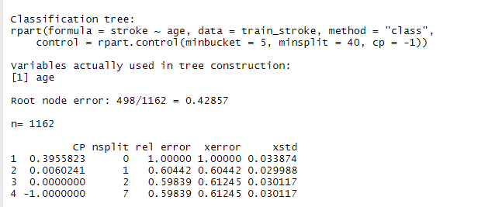
Decision Tree : Age

Slide 25
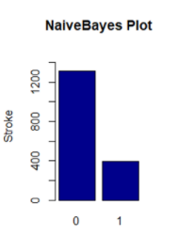
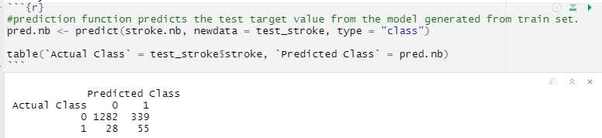
Naïve Bayes
stroke.nb <- naiveBayes(stroke ~ ., data = train_stroke)
78.46% Accuracy for predicting the occurrence of strokes within patients.

Slide 26
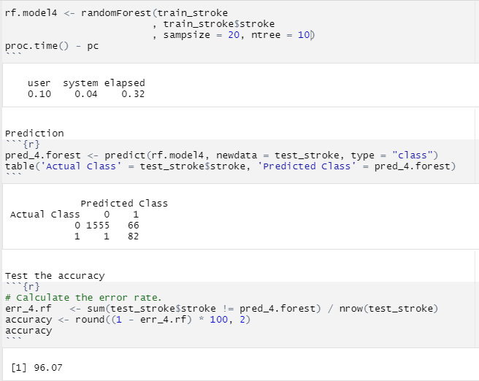
RandomForest

Slide 27
Model Comparison
Decision Tree
- Model 1 (all variables): 74.35%
- Model 2 (age): 75.23%
- Model 3 (age, hypertension, bmi): 74.18%
Random Forest
- Model 1 (all variables): 78.17%
- Model 2 (age): 75.23%
- Model 3 (6 predictors, excludes smoking status): 77.23%
- Model 4 (all variables, sampSize = 20, ntree = 20): 96.07%
Naïve Bayes
- Model 1 (all variables): 78.46%
- Model 2 (age): 75.23%
- Model 3 (age, avg glucose, smoking status, heart disease): 76.64%

Slide 28
Model Comparison
The decision tree, naïve bayes, and random forest models were all very good predictors of stroke occurrence within patients.
However, random forest gave the highest level of accuracy than the other two models by stratifying the training data and using all variables used in its model.
Decision tree model produced its highest accuracy with only one predictor variable.
Naïve Bayes performed its best when using all seven predictors in its model.

Slide 29
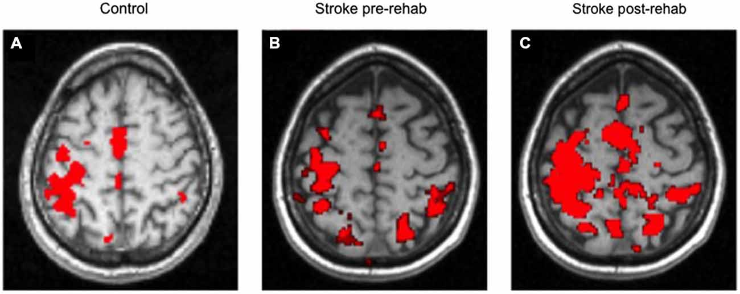
Questions?

